Slide 1
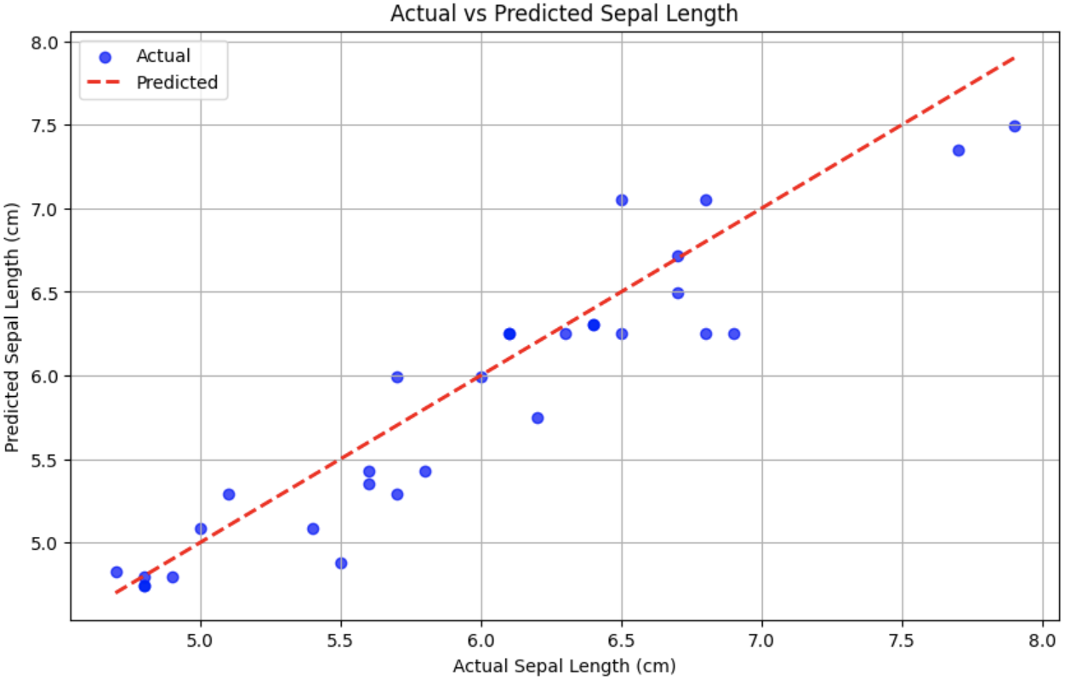
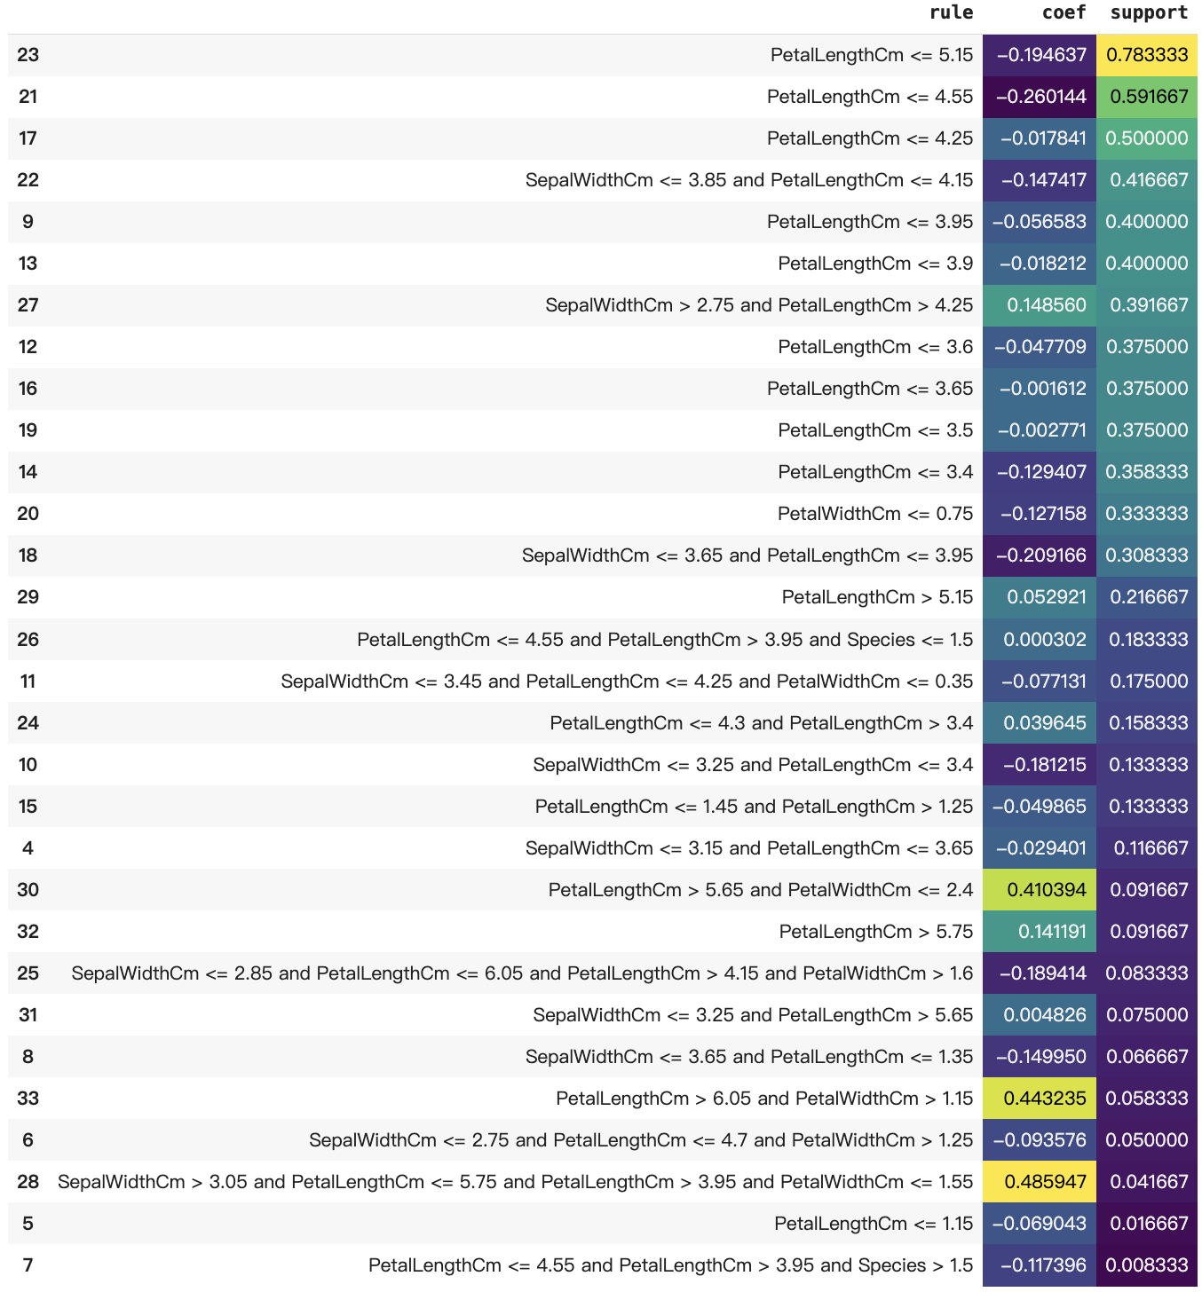
Rule Fit Regressor
How it works:
Combines rules extracted from decision trees with linear terms for regression.
Extracts interpretable decision rules from tree-based models.
Uses these rules alongside linear terms to make predictions.
Provides interpretability by allowing individual rules to be understood and analyzed.
Effective in handling both categorical and continuous features.
Suitable for tasks requiring a mix of linear and non-linear relationships.
The RMSE for Rule Fit Regressor in this case is 0.322.
Pros:
Adds feature interactions to linear models
Rule fit works for both classification and regression
Interpretability
Cons:
Increasing number of features harms interpretability
Overlapping rules cause difficulties in interpretation

Slide 2
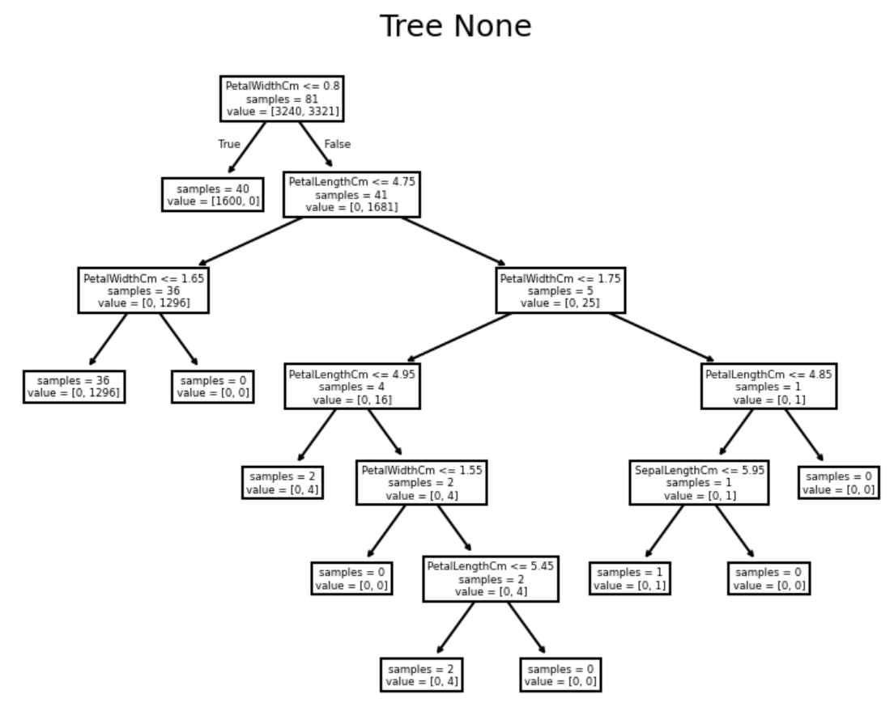
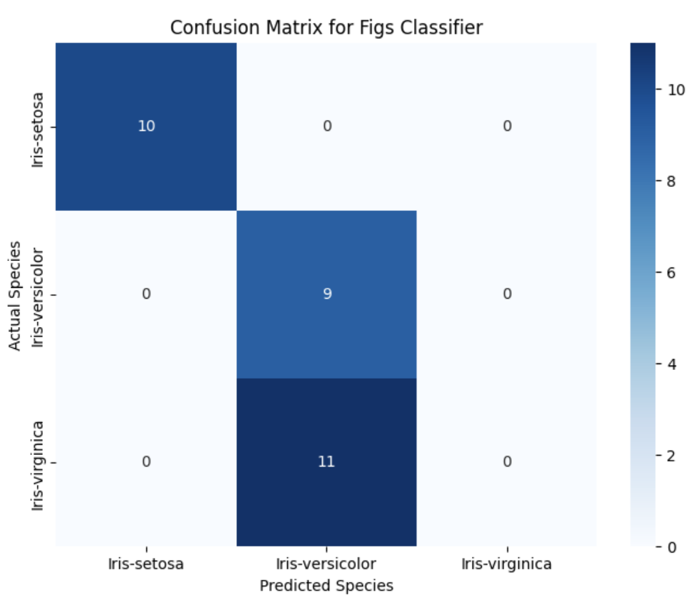
FIGS Classifier
How it works:
Constructs decision rules through a greedy, interpretable process.
Builds decision trees incrementally to minimize classification error.
Each tree split maximizes the classification performance on a subset of data.
Generates highly interpretable models with decision rules that can be easily understood.
Effective in cases where interpretability is as important as accuracy.
Produces compact models that can be efficiently evaluated.
The accuracy for FIGS Classifier in this case is 0.633.
Root Node (PetalWidthCm <= 0.8): The first decision asks whether the petal width is less than or equal to 0.8. This splits the data into two branches:
Left Branch (True): If PetalWidthCm <= 0.8, it leads to the left side, containing 40 samples from class 1.
Right Branch (False): If PetalWidthCm > 0.8, it moves to the right, containing 41 samples that need further splitting.
Left Subtree:
At the next split, PetalWidthCm <= 1.65, the samples are further split. If true, 36 samples are classified as class 1. If false, no samples remain in that branch.
Right Subtree:
For samples where PetalWidthCm > 0.8, the next condition is whether PetalWidthCm <= 4.75. This branch is further split by various petal and sepal length/width conditions, classifying the remaining samples into either class 1 or class 2 based on those criteria.
Leaf Nodes: At the bottom of the tree, each leaf node provides the final classification

Slide 3
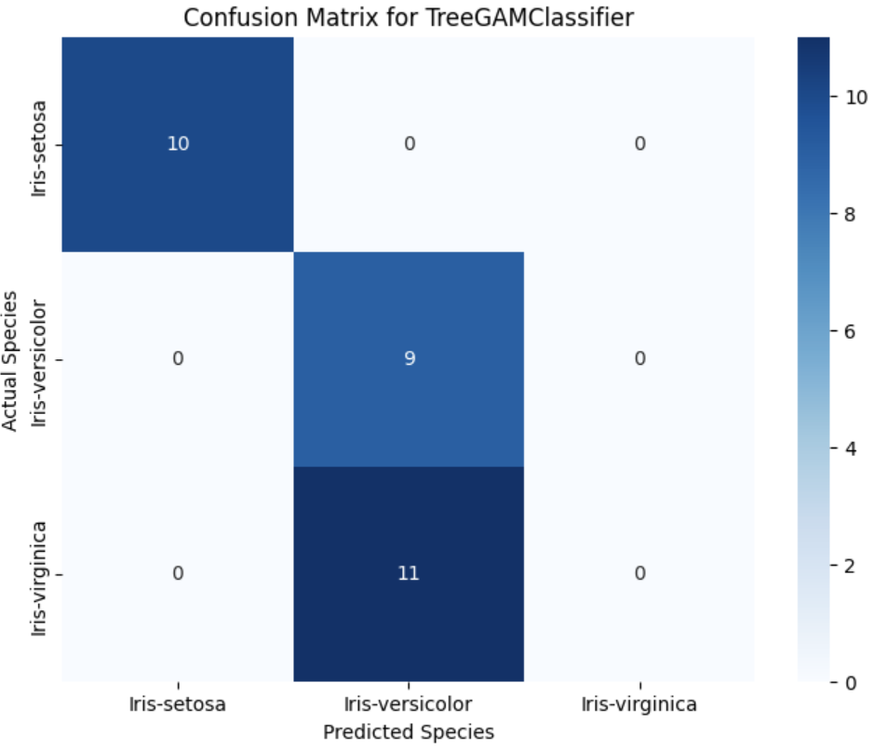
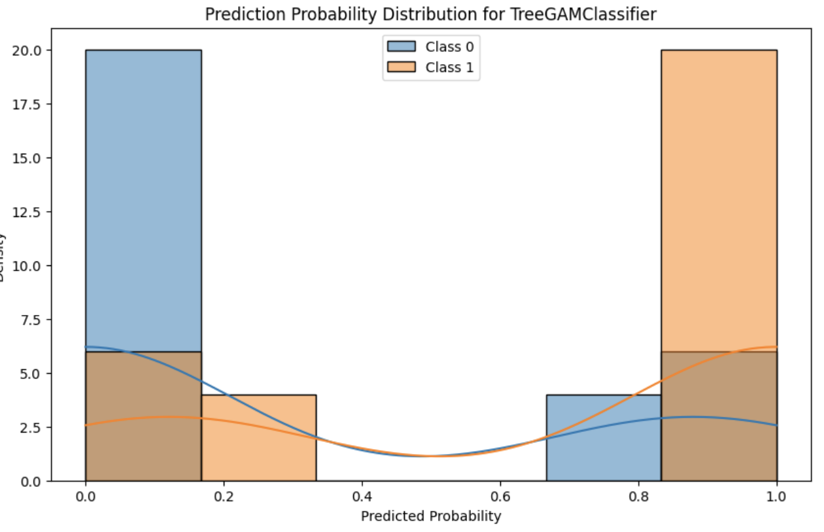
Tree GAM Classifier
How it works:
A tree-based Generalized Additive Model (GAM) for classification tasks.
Combines tree-based models with additive components for flexibility and interpretability.
Models the relationship between input variables and the target as a sum of non-linear functions.
Captures non-linear relationships without sacrificing interpretability.
Effective for datasets with complex, non-linear interactions.
Suitable for tasks that require balancing accuracy and model interpretability.
The accuracy for Tree GAM Classifier in this case is 0.633.
Prediction Probability Distribution for Tree GAM Classifier:
Probability Distribution Peaks at 0 and 1:
For Class 0 (blue bars), we see that most of the predicted probabilities are concentrated at 0 and 1. This suggests that the model is confident in its predictions, assigning high or low probabilities (close to 0 or 1) rather than probabilities in the middle.
The same applies to Class 1 (orange bars), where most predictions are concentrated at probability values close to 1 (for Class 1) or close to 0 (for Class 0).
Lower Density at Intermediate Values: There are very few instances where the model assigns probabilities between 0.4 and 0.6.

Slide 4
Comparison
Aspect | RuleFit Regressor | FIGS Classifier | TreeGAM Classifier
Type | Regression | Classification | Classification
Interpretability | High: Combines decision rules with linear terms | High: Builds interpretable decision trees through greedy process | High: Interpretable additive tree-based model
Core Algorithm | Rules extracted from decision trees and linear models | Greedy decision tree splitting | Generalized Additive Model (GAM) with tree-based components
Handles Non-linearity | Yes: Rules capture non-linear relationships | Yes: Trees naturally capture non-linear relationships | Yes: Additive components handle complex, non-linear patterns
Key Strengths | Interpretable combination of rules and linear terms Can handle both categorical and continuous features | Produces compact, interpretable decision trees Efficient and accurate | Captures non-linear interactions Balances flexibility and interpretability
Weaknesses | Limited to regression tasks Complexity increases with many rules | - Might not capture highly complex relationships without deep trees | - May require careful tuning for very high-dimensional data
Best Use Cases | - Regression tasks where interpretability is critical | - Classification tasks with a need for clear decision paths | - Classification with non-linear relationships between variables
Model Complexity | Moderate: Complexity grows with more decision rules | Low to Moderate: Generates compact decision trees | Moderate: Can handle non-linearities but remains interpretable

